Slide 1
Self Balancing Unicycle

Slide 2
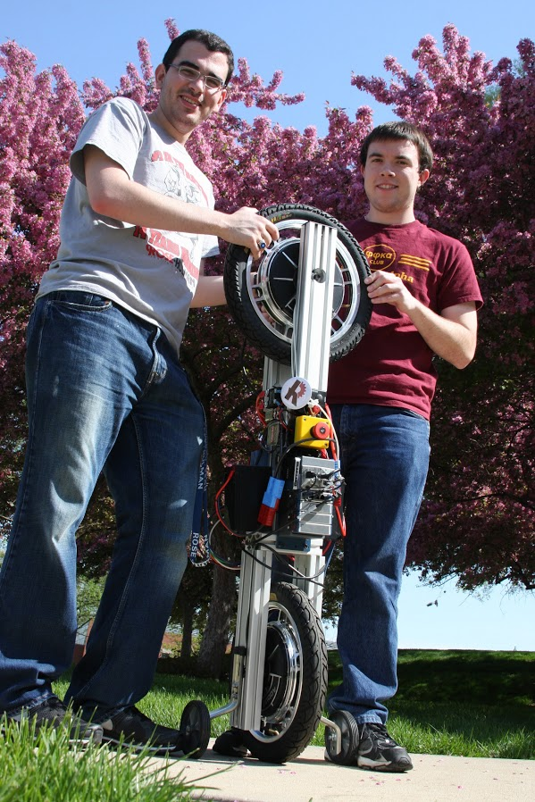
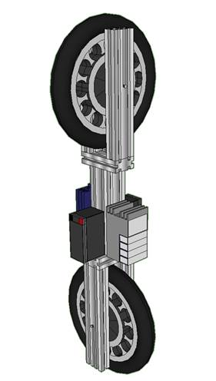
Project Overview

Slide 3
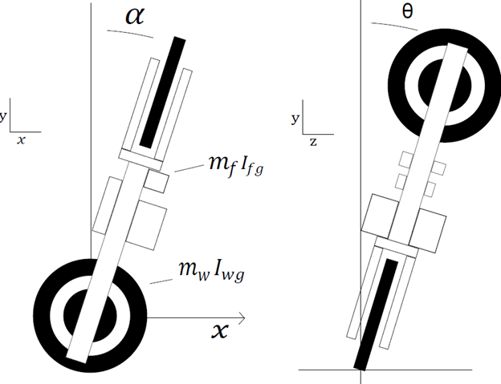
System Description

Slide 4
System Modeling

Slide 5
Technical Specifications
pic of cRIO, motor controller

Slide 6
Controls

Slide 7
Unforeseen Challenges

Slide 8
Testing Plan

Slide 9
Suggestions for Improvement

